Slide 1
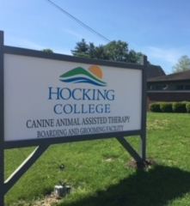
Hocking Hounds
Joseph-Treasurer
Seth -Chair
Darius-Vice-Chair
Mariah-Secretary
Zongzhi
Chase

Slide 2

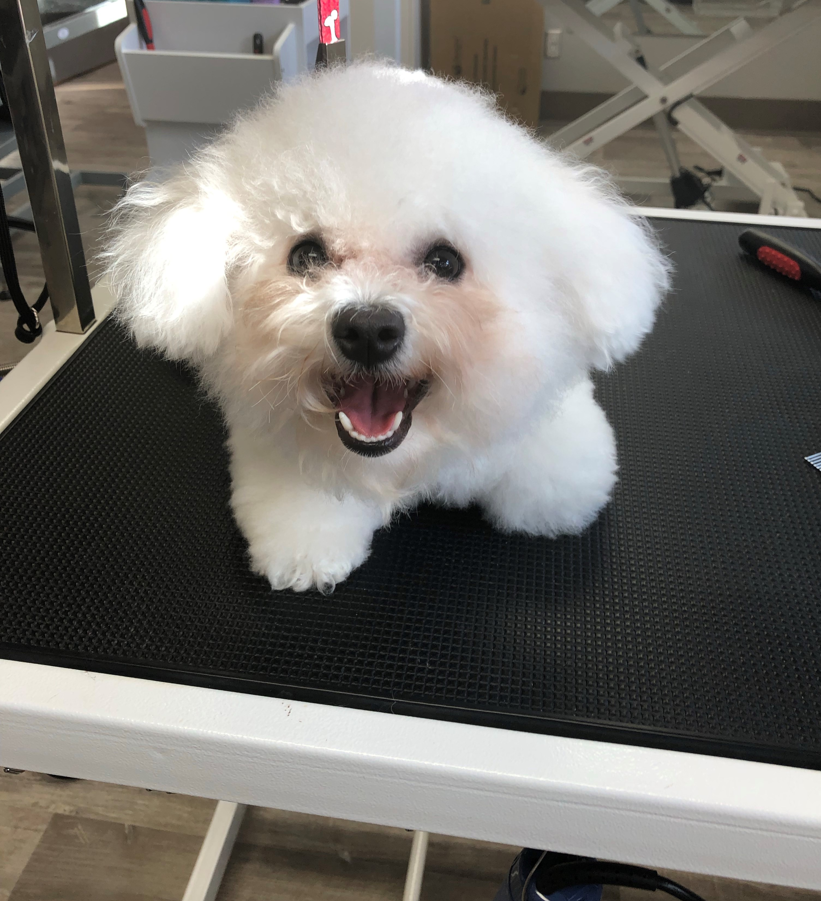
Ideas and organization came from how the team would want an organization such as this to treat our own animals in a Boarding or Grooming Situation, as well as the care & services we would like offered to us as individuals.

Slide 3
How did The Hocking Hounds Work As a Team?
In our meetings everyone came together to find things that we would like to see in the future for the company, such as:
  How the dogs will be treated. We all agree that we should not pay extra for our dog to get attention while they are away getting groomed. That should be included in the price you pay for them to get groomed. No dog should have to sit in a dirty cage with other dogs while waiting to get picked up.
  We all agreed on that whomever is cutting the dogs hair should be qualified and have knowledge on the dog's background.
  The expectations for the company. Such as, cleanness, certification, size of kennels. Large dogs should not be crammed up in a cage for a small dog.

Slide 4
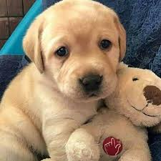
Pet Business's
Demand for industry services is expected to heighten as the number of pet owners rises.
The Pet Grooming and Boarding industry has nearly doubled over the past decade.
The demand for high quality pet grooming and boarding is high due to the increase in pet ownership and changing consumer preferences for better pet care.
Revenue is anticipated to grow at steady rate.

Slide 5
Overview of the Business
This future company is a local business of Nelsonville, the only one, to get your dog groomed.
We believe in treating your dog the way you would treat your dog.
Customer Service
A way to get your dog's haircut for a good price. Not having to pay extra just to get your dog attention.
An educated vet working with your dog and first-aid knowledge

Slide 6
Online Website
We want our website to be as easy as possible for all our customer's needs.
This is where we will have a list of the available services we offer, business hours, and contact information for any questions that may need personal assistance.
Simple/consumer friendly website that we can market easily.

Slide 7
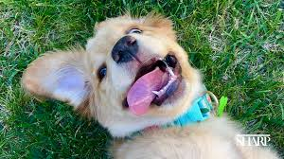
Financial Status
Status at this time is in the red due to “New Business”, but will soon be up and running.
The outlook is good due to the low number of grooming salons in the area and the need for higher quality boarding facility in the area.

Slide 8
Key Challenges
New business, so not many people can give a review to new people to get more business.
College students working, this may be a problem to some people that do not like new people working with their dog.
Not many way's to advertise yet because the business has not opened yet.
Goals are to diversify offerings and keep focus on superior service and education for customers.
Be able to take advantage of new opportunities and slowly but surely improve economic conditions to build growth.
Risk management in any pet business is important and safety of the pet is always number one priority.

Slide 9
What Works Well?
Because the business has not opened yet, we cannot tell what works well and what does not, but we tell you what we have added to the building to help make sure everything works well, such as
Different size dog beds
Doggie doors that open and close easy for workers
Adding a fence for the dogs to be able to have free time outside and elimination purposes
The layout for grooming and boarding areas is up to date and highly functional for the needs of this business.
The safety and supervision of pets is easily conducted in the work and kennel spaces provided.

Slide 10
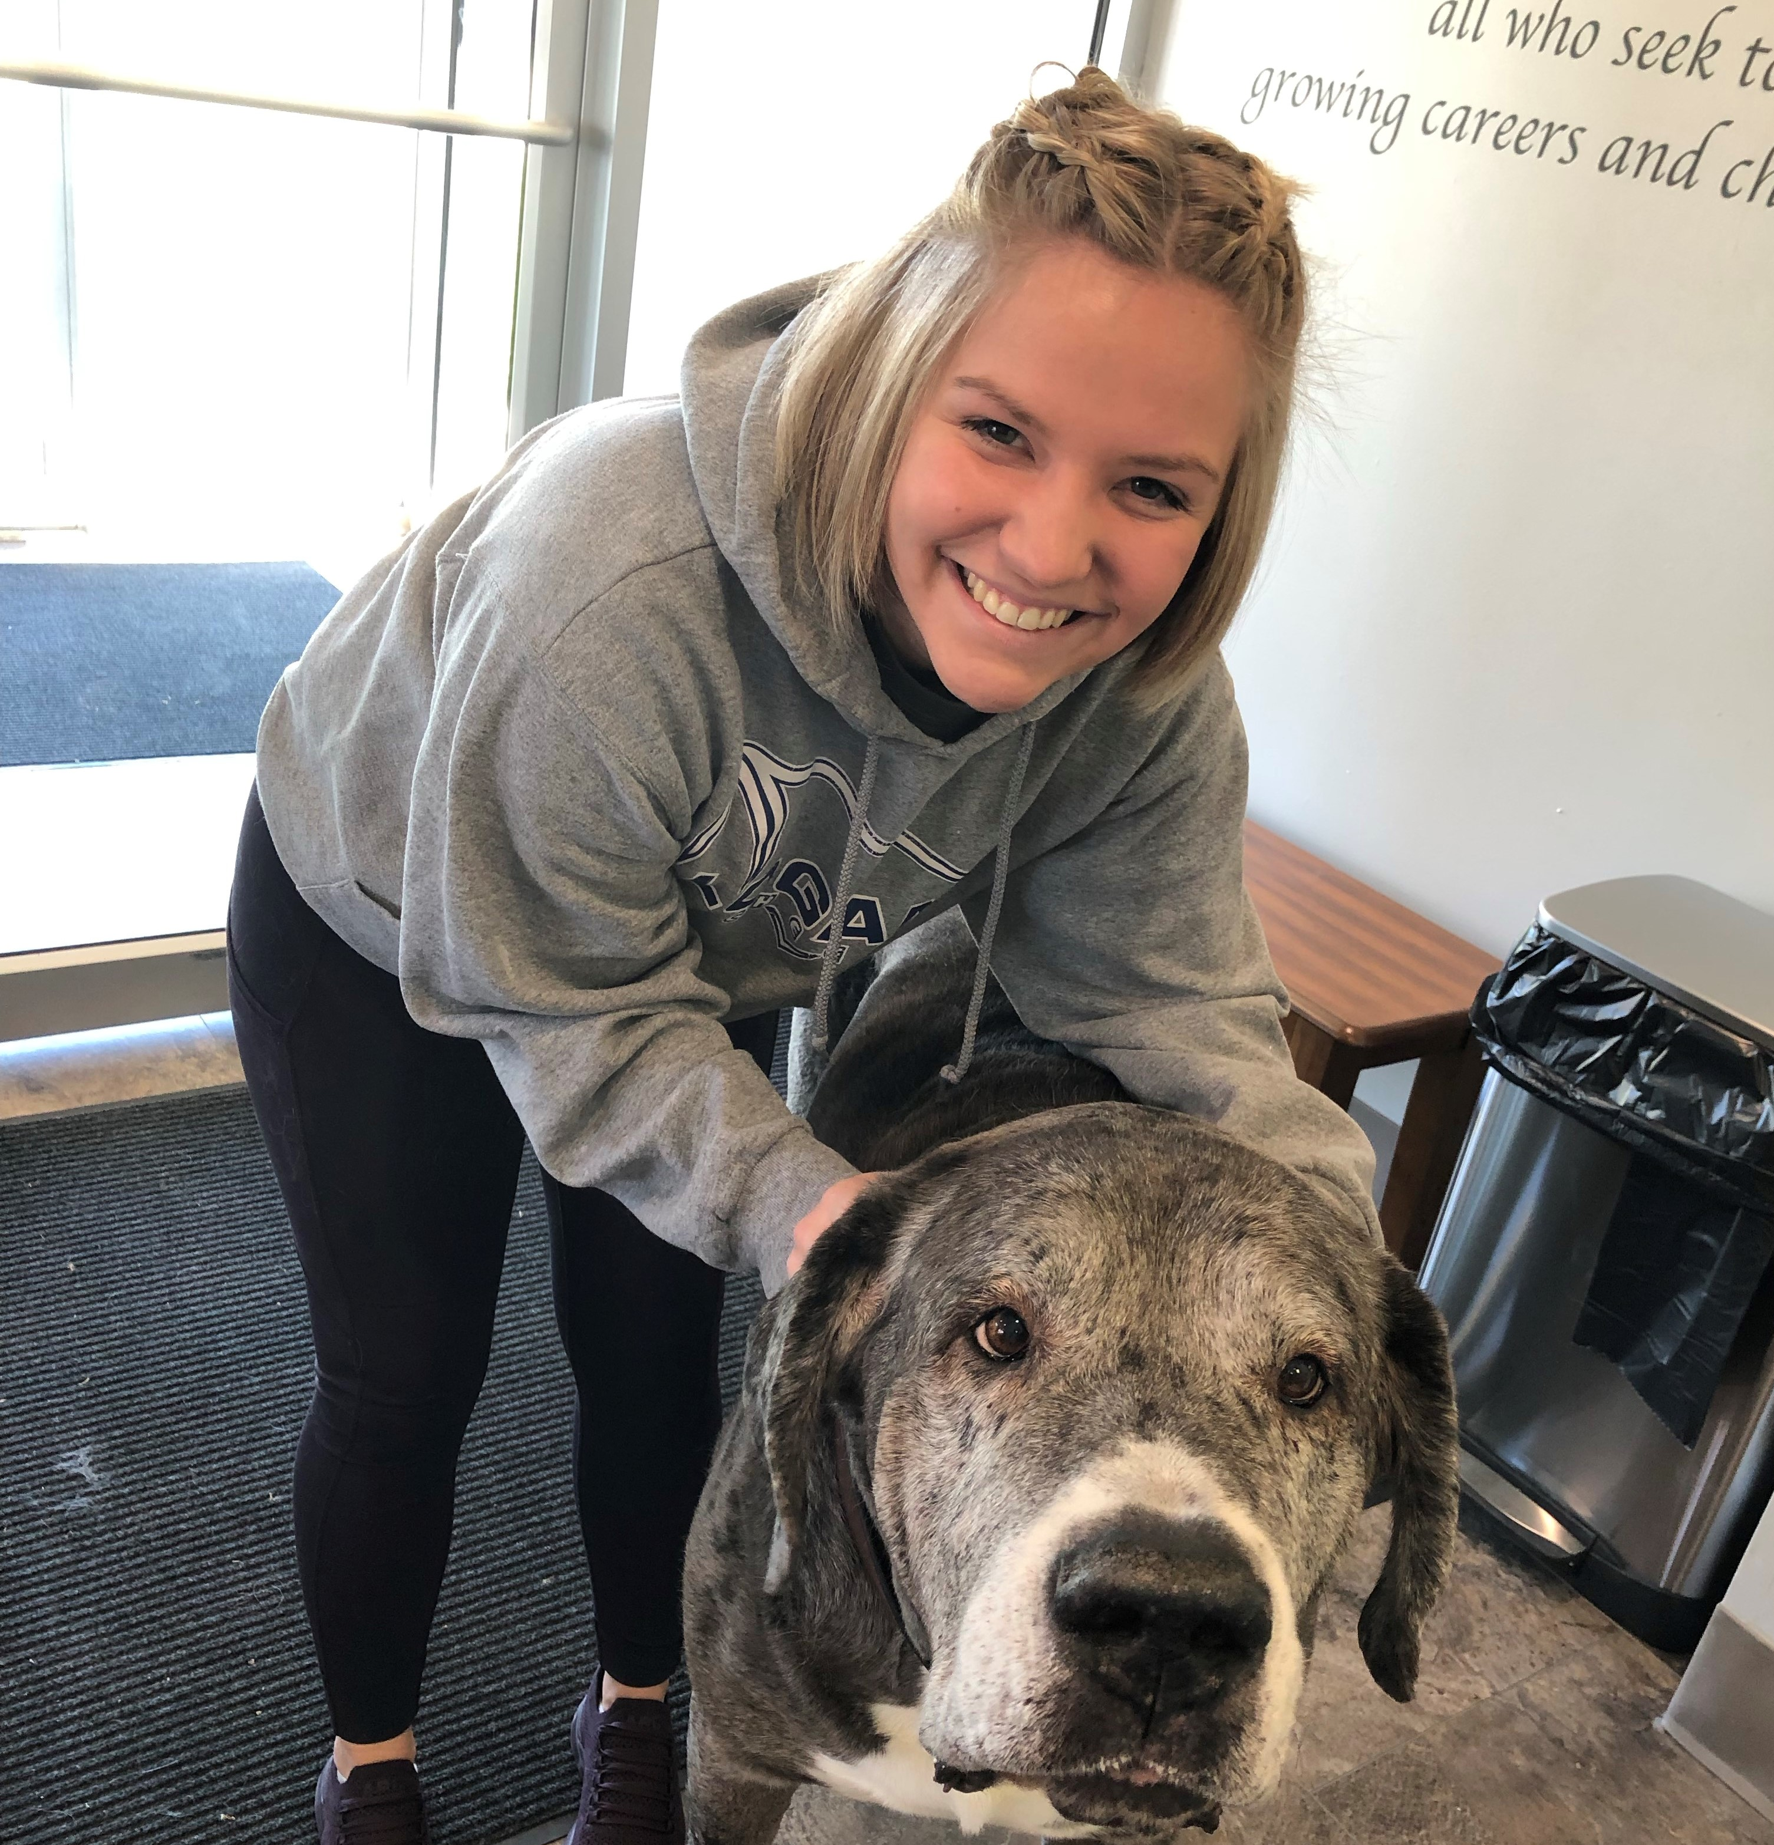
What Did We learn?
How to become a business leader.
Ways to advertise your business.
What we would have to do to start up a business.
Common prices of areas groomer and boarders.
How few high-quality boarding and grooming facilities there are in a 20 mile radius.
How most boarding facility’s place pets in run and charge extra for TLC care!

Slide 11
Team Recommendations
Local Advertisement, in stores, online, restaurant's and over school.
Ways to market
Hours we should open
Fencing

Slide 12
              Advertising
Spot in local paper for local community to see.
Website must be up and running for people to check services offered.
Commercial on local Radio or TV.
Place the “Business Phone Number” large above front door so that people can see from street.

Slide 13
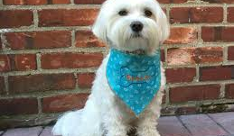
Marketing/Fundraisers
Sell T-shirts for owners and Bandannas for pets with Hocking College Logo.
Pass out and hang flyers once business is “open” to area pet related gatherings.

Slide 14
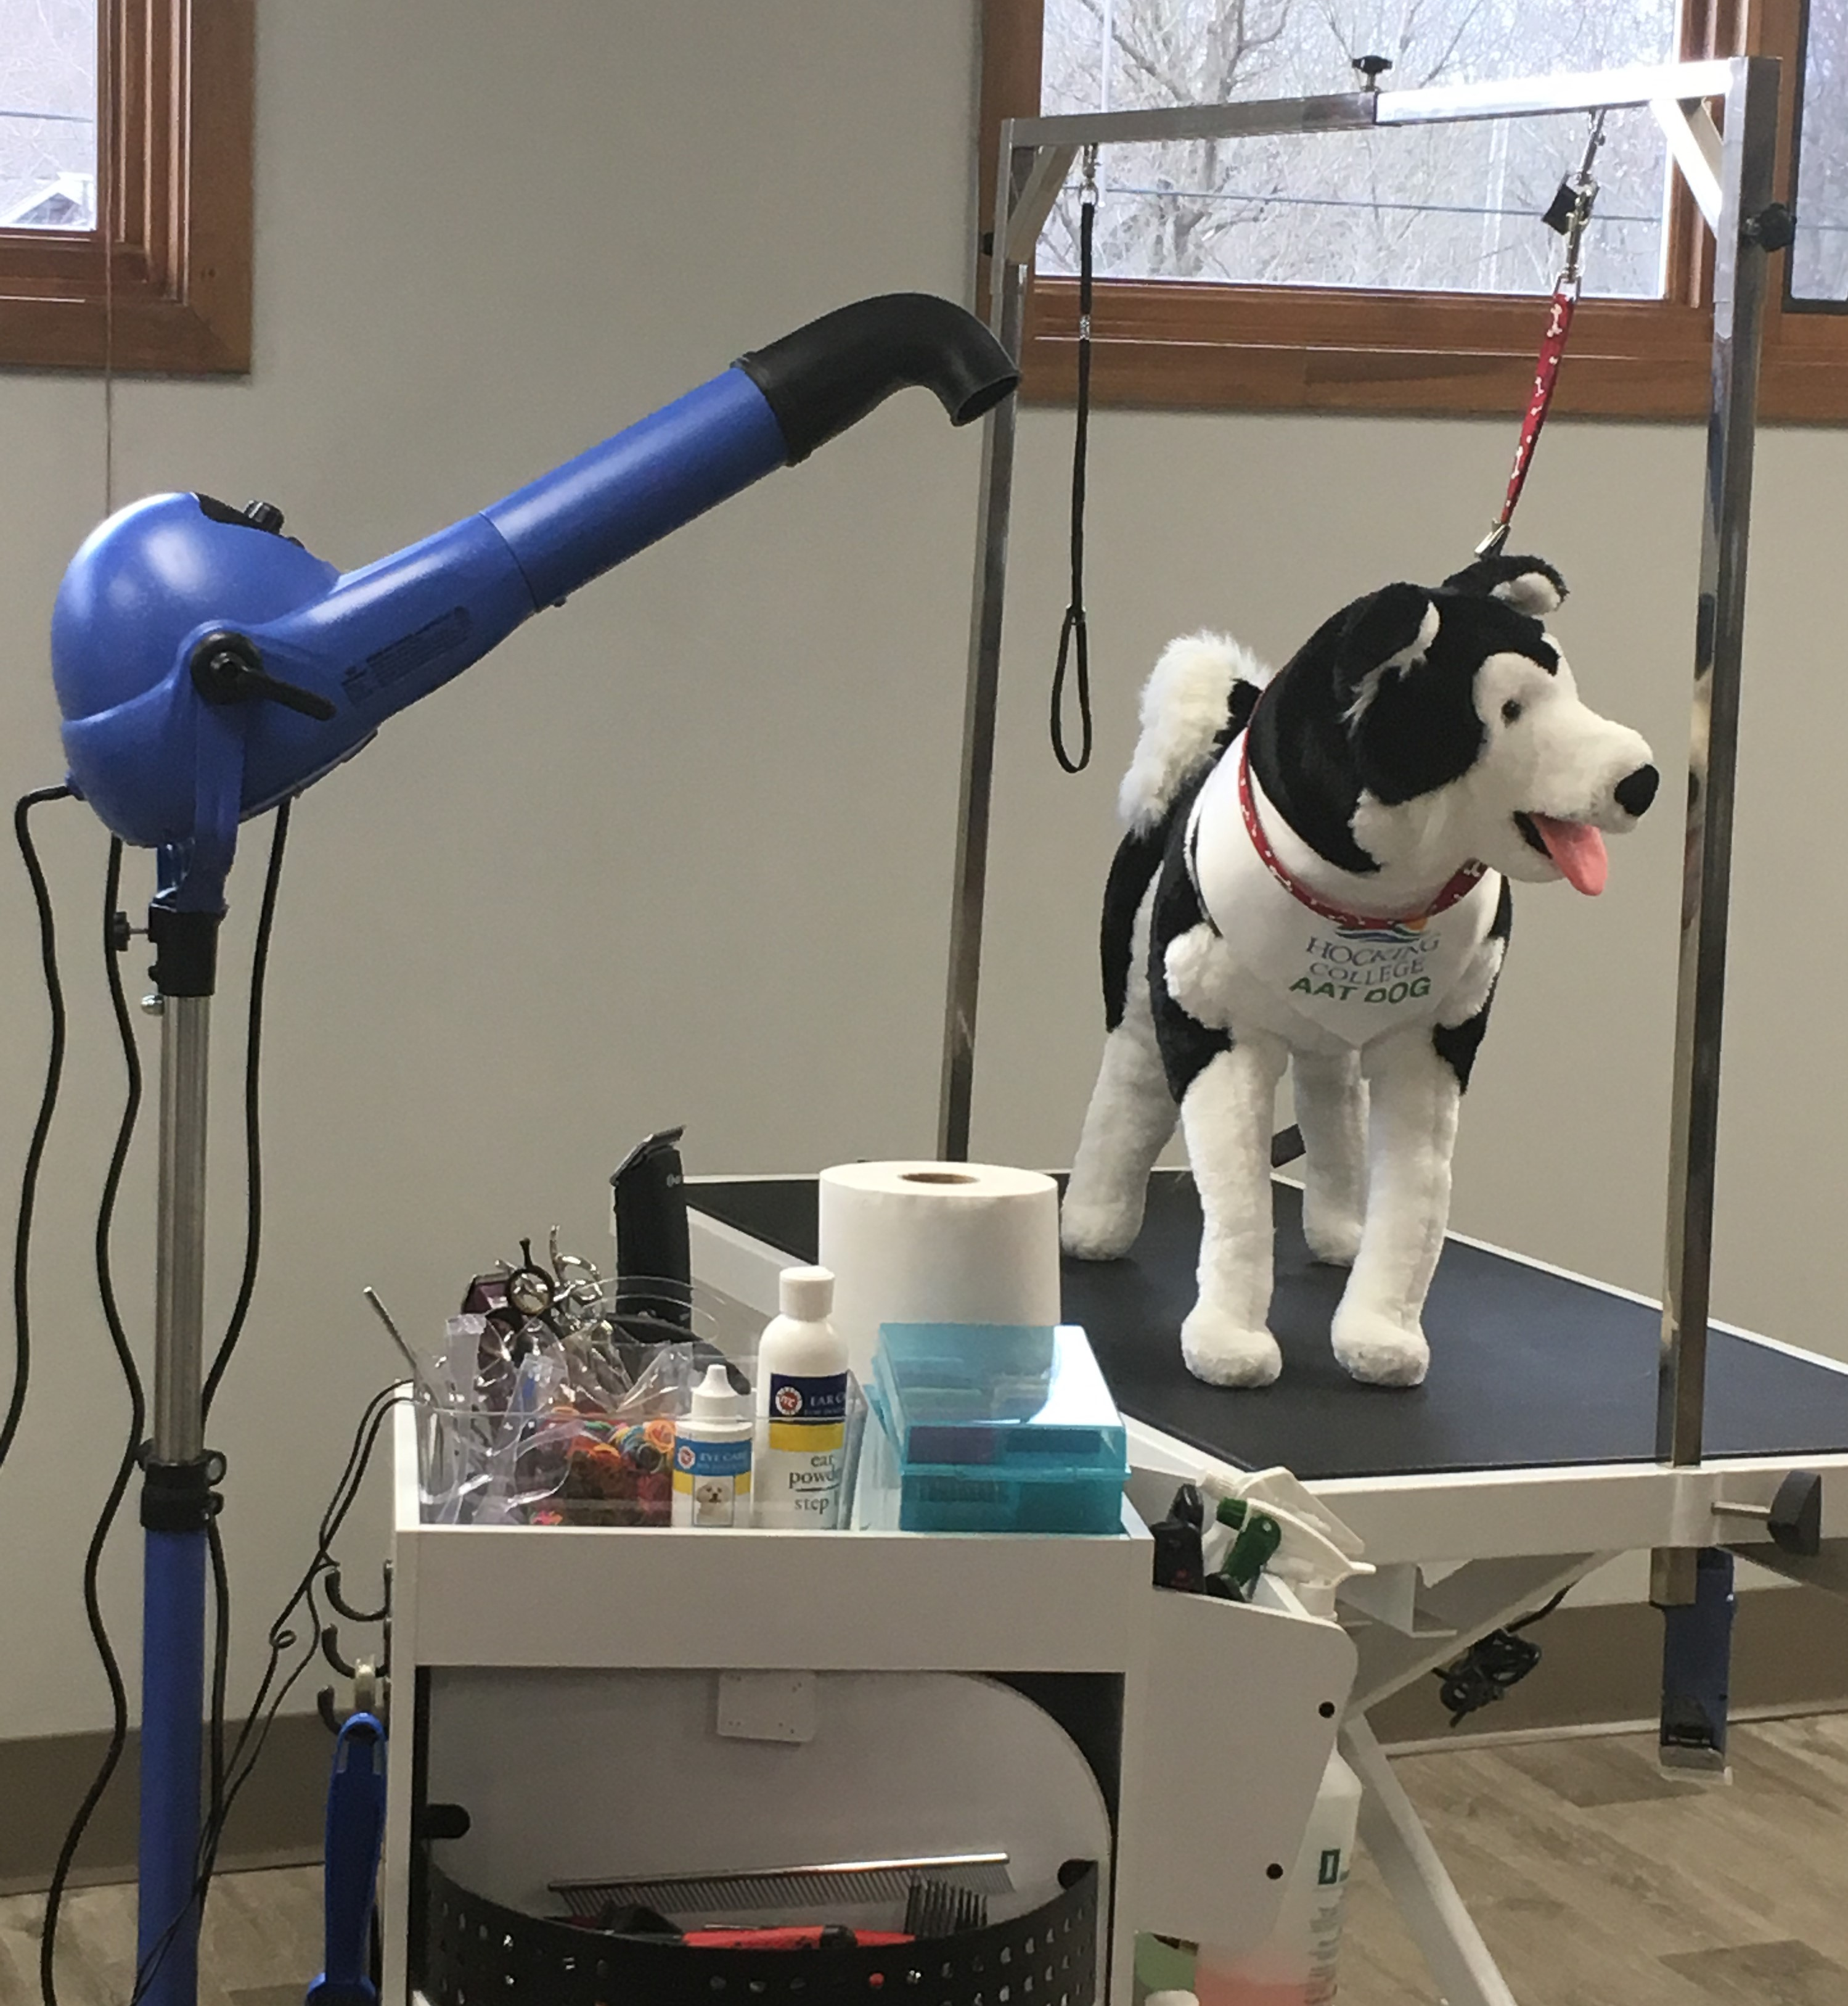
First Aid Classes
Offer these classes to the public for a cost to boost income and spread business information and opening.

Slide 15
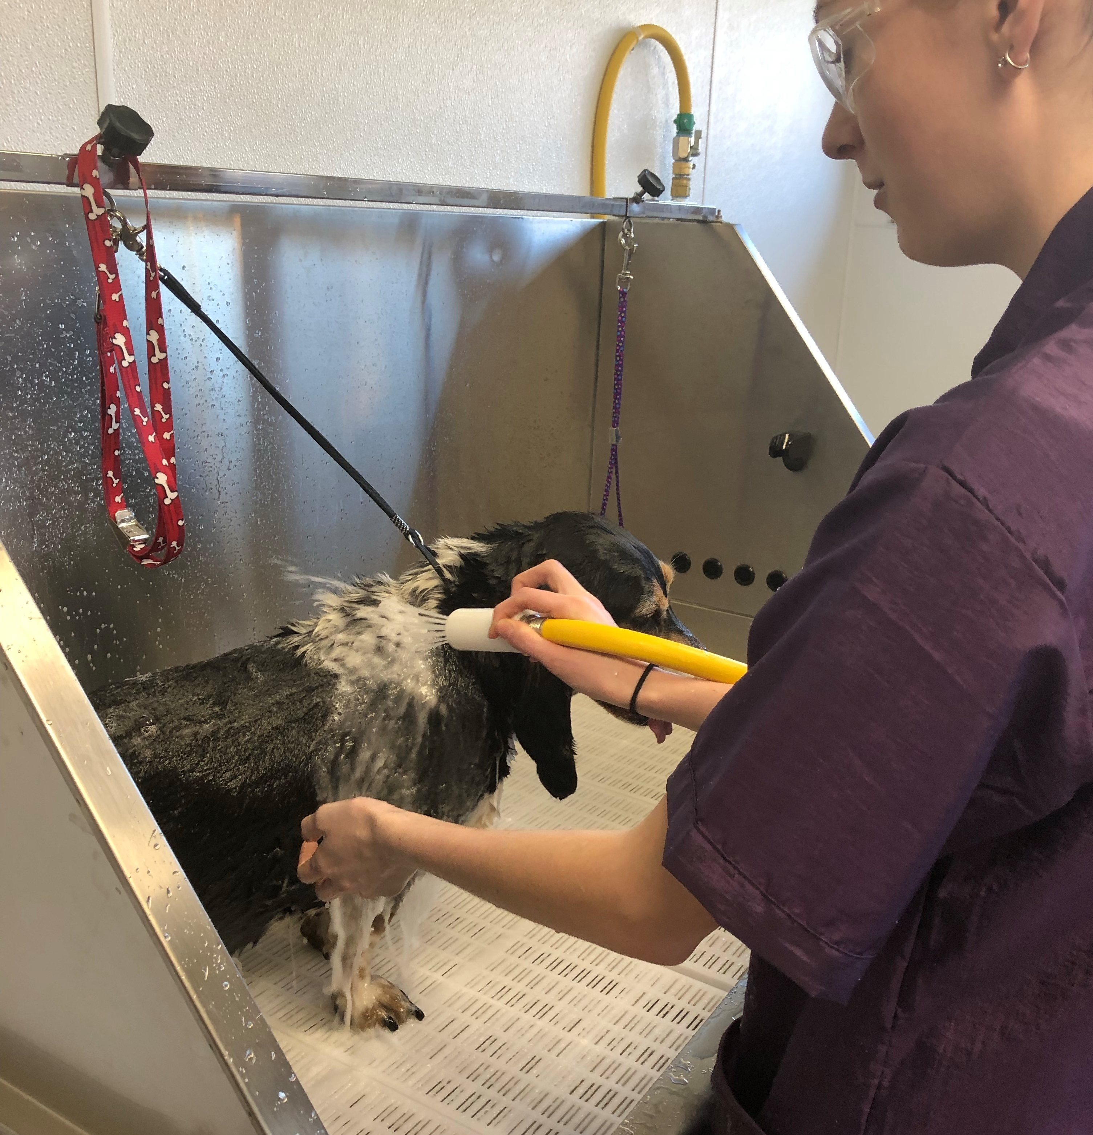
Have a poster advertisement and "biography" like information on Ms. Conner’s background.
Also her views on pet care and the quality of pet care that pet’s will be given while at Hocking College Canine Facility.
Have this posted out front where people can read it while waiting or dropping off their pet.

Slide 16
Pricing
Keep grooming prices fair for student work but still profitable to ensure business growth.

Slide 17
Why we would recommend?
When you advertise your company, you get more network and that leads to more business. If you put advertisements in local spots, local people will talk and then more people will inquire about services.
Hours opened can vary so a sign clearly displaying this will be helpful, due to school hours that the college is opened, or we could open before school/class and during the weekend at least one day to make more income.
Also short fencing out front will secure sanitation for clients so that dogs that are not vaccinated or have worms can't contaminate client dog walking areas.

